Slide 1
Evolve to Modern Management
Doug Wilson
@ManageDoug
Solutions and Product Manager, Now Micro

Slide 2
Get Involved
Join or Start your local user group
Participate in forums
Technet
MyItForum
Microsoft Tech Community
Etc…
Get on Twitter
Not just for celebrities and presidents
Keep a Blog

Slide 3
Agenda
What is Modern Management
The Role of SCCM
The Role of Intune
WaaS (Windows as a Service)
SCCM Co-Management (Step into Intune)
Intune (More than Mobile Device Management)
Compliance
Configurations
App Management
Round Table / Q&A
Autopilot
Moving towards Intune
Choices on testing
Windows Store for Business (Edu)

Slide 4
Why look at modern management?
Windows 10 is in a state of constant updates and upgrades
Wider variety of devices means a larger attack vector
We care about identity protection
We can empower users no matter what device they have to create a more rounded experience
Log Analytics

Slide 5
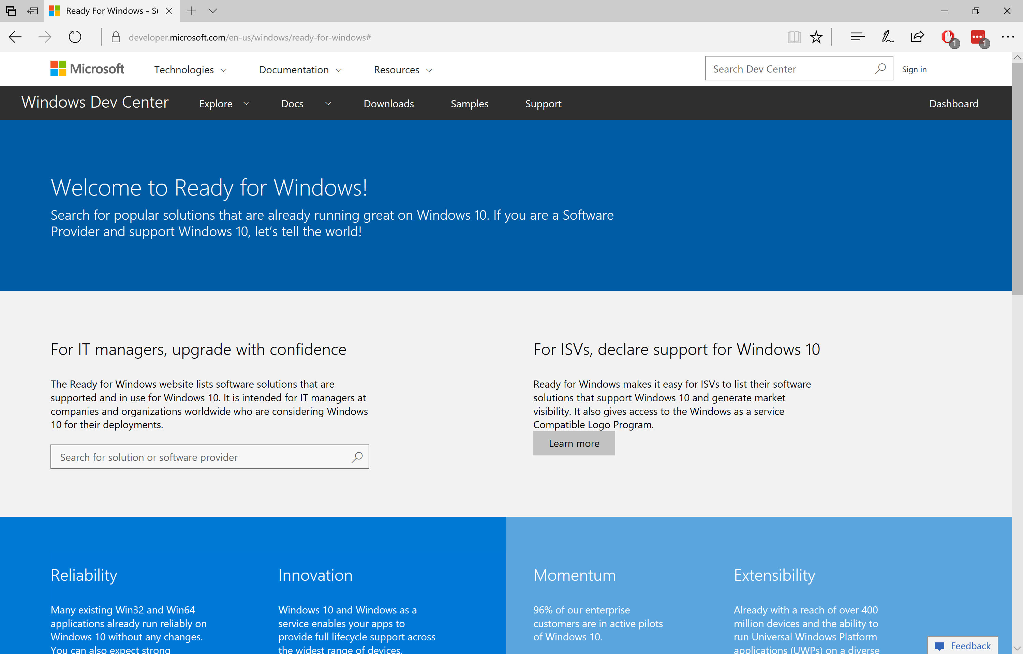
Ready for Windows
Get links to Windows 10 ISV support statements
Get usage information for every app version, and use that to target testing
http://www.readyforwindows.com
We are actively engaged with ISVs, to ensure full support for Windows as a service

Slide 6
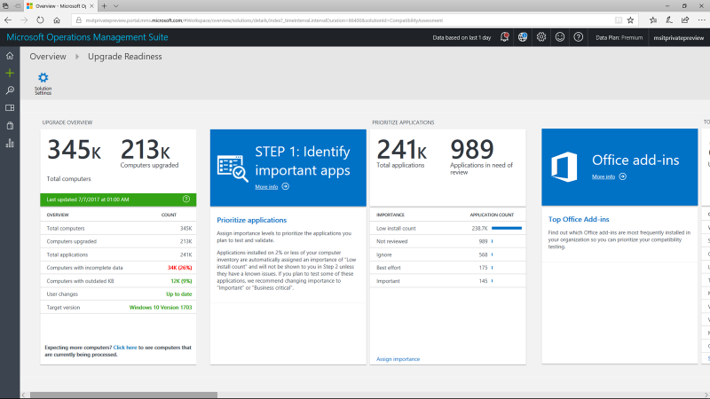
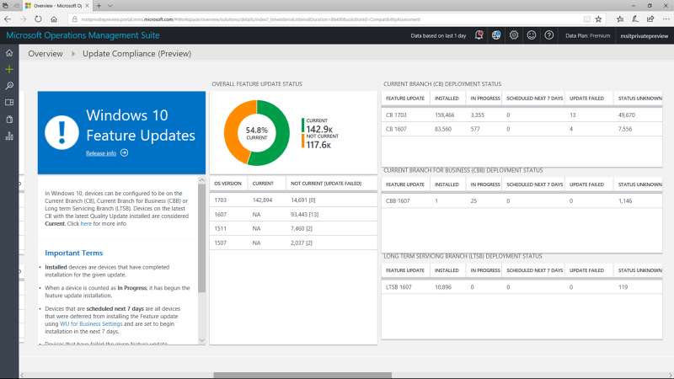
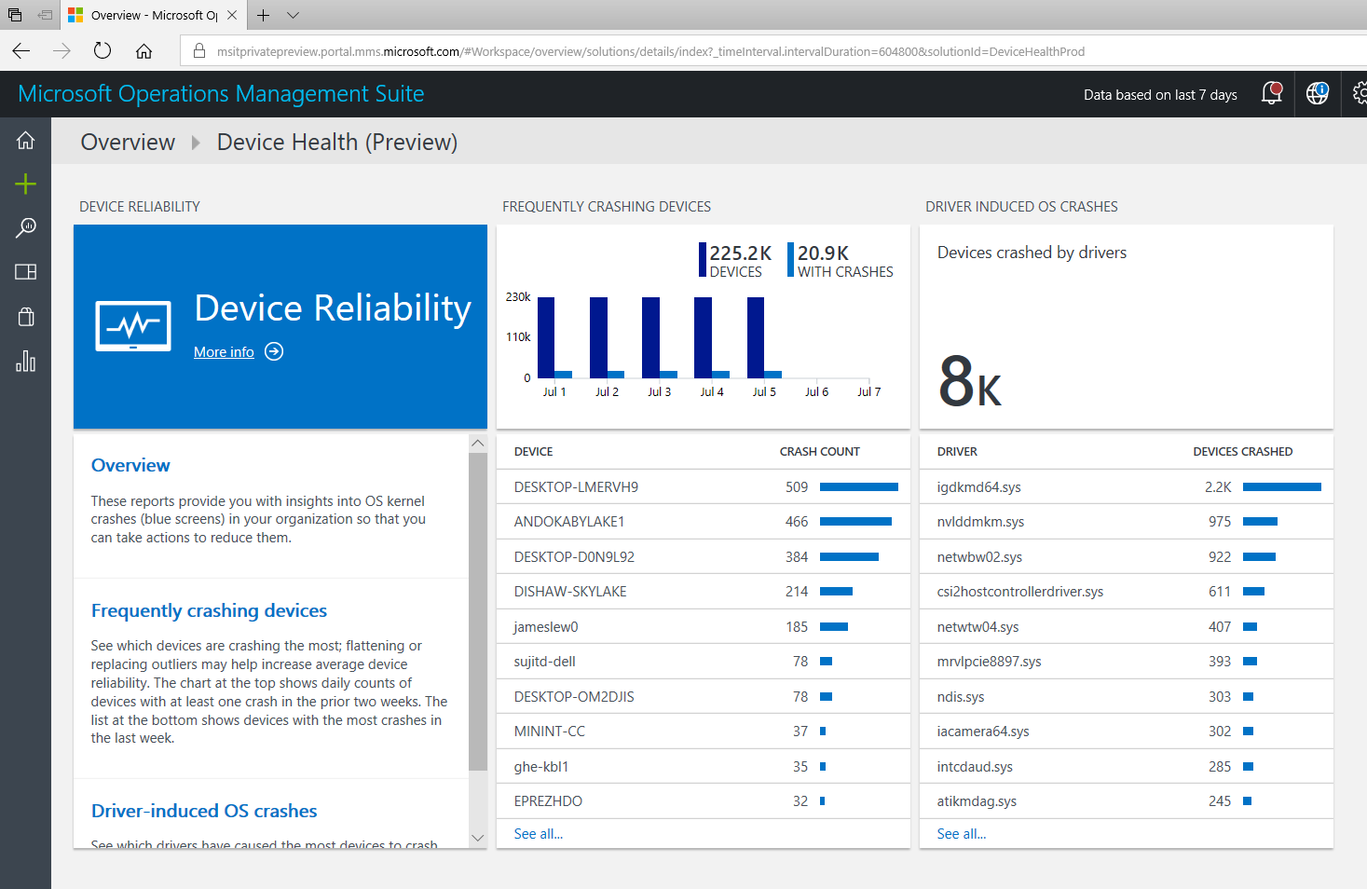
Windows Analytics A suite of tools reduce deployment and support costs
Upgrade Readiness
Update Compliance
Device Health
Plan upgrades by identifying devices that are ready and identify and resolve top app/driver compat blockers.
Ensure update and antimalware compliance with timely reports for all your devices (even those on the road).
Reduce support costs by proactively identifying and remediating top end-user impacting issues.

Slide 7
Show off Windows Analytics+ And Microsoft Store

Slide 9
Itemized Agenda
What is Modern Management
The Role of SCCM
The Role of Intune
WaaS (Windows as a Service)
SCCM Co-Management (Step into Intune)
Intune (More than Mobile Device Management)
Compliance
Configurations
App Management
Round Table / Q&A
Autopilot
Moving towards Intune
Choices on testing
Windows Store for Business (Edu)

Slide 10
Co-Management FYI
Requirements to keep in mind
Azure AD Premium
EMS or Intune Licensing
Legacy Intune portal should not be in use anymore
Devices need to be Registered or joined into Azure AD
Hybrid management is a great idea for using co-management

Slide 11
Co-management supports the following workloads:
Compliance policies
Windows Update policies
Resource access policies
Endpoint Protection
Device configuration
Office Click-to-Run apps
Client apps

Slide 12
Demo Co-Management Setup

Slide 13
Itemized Agenda
What is Modern Management
The Role of SCCM
The Role of Intune
WaaS (Windows as a Service)
SCCM Co-Management (Step into Intune)
Intune (More than Mobile Device Management)
Compliance
Configurations
App Management
Round Table / Q&A
Autopilot
Moving towards Intune
Choices on testing
Windows Store for Business (Edu)

Slide 14
What we manage with Intune
Device Enrollment Capabilities
Compliance Management
Policy Management (Similar to GPO)
App Management

Slide 15
Itemized Agenda
What is Modern Management
The Role of SCCM
The Role of Intune
WaaS (Windows as a Service)
SCCM Co-Management (Step into Intune)
Intune (More than Mobile Device Management)
Compliance
Configurations
App Management
Round Table / Q&A
Autopilot
Moving towards Intune
Choices on testing
Windows Store for Business (Edu)

Slide 16
WINDOWS AUTOPILOT
Cloud-Driven
Simple, IT-Driven
Teacher-Driven
Pre-register devices in the cloud via the Windows AutoPilot deployment service
Device completely configured with no IT intervention required
Use the Windows Configuration Designer to create a package containing customizations
Package copied to each computer, installed to customize the PC
Wizard-driven “Set up School PCs” app to create a USB key with school-specific customizations
Set up additional PCs in just a few minutes using that USB key

Slide 17
Demo Autopilot

Slide 19
Itemized Agenda
What is Modern Management
The Role of SCCM
The Role of Intune
WaaS (Windows as a Service)
SCCM Co-Management (Step into Intune)
Intune (More the Mobile Device Management)
Compliance
Configurations
App Management
Round Table / Q&A
Autopilot
Moving towards Intune
Choices on testing
Windows Store for Business (Edu)

Slide 20
Evolve to Modern Management
Doug Wilson
@ManageDoug
Dougw@nowmicro.com
Solutions and Product Manager, Now Micro

